Slide 1

ADVANCED BUSINESS ANALYTICS

Slide 2
Company Background
Hire Heroes USA is a non-profit organization which empowers U.S. military members, veterans and military spouses to succeed in the civilian workforce through free, individualized career coaching programs.
Hire Heroes USA has built a national reputation of excellence for helping veterans find jobs: now at the rate of more than 60 veterans confirmed hired every week.
Founded: 2005, by John Bardis, former CEO of MedAssets
Headquarters: Alpharetta Georgia, United States.
Number of locations: 7

Slide 3
Problem Statement
HHUSA wants to reach out to the untapped population by analysing existing data to know more about how to improve further:
To find Relationship between amount of time spent working with clients and how quickly they are employed.
Measures utilized to evaluate the process efficiency and program performance, Along with alternative measures to maximize the reporting accuracy and efficiency.
Possibility of correlating client and employer demographic data and current method of matching clients to employers to identify effective ways to connect clients to companies.
Is working with volunteer increase the probability of client getting hired? Are there any volunteer activities that are more effective than others? Does this increase the quality of job obtained?

Slide 4
Data source
The data set has 7 different files.
Contact file: Clients are listed under the Contacts object as Candidates, Workshop Participants, Onward to Opportunity, and AVR record types.There are totally around 65k clients.
Account file: Companies, businesses, and other corporate partners are listed under the Accounts file.It has 12,967 distinct records.
Case file: Tasks and Cases objects include activities that are associated with Contacts and Accounts objects.
User file: Information regarding the employee , their region , position etc are stored.

Slide 5
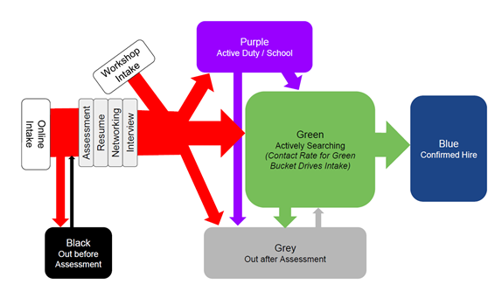
Color codes of Hire Heros

Slide 6
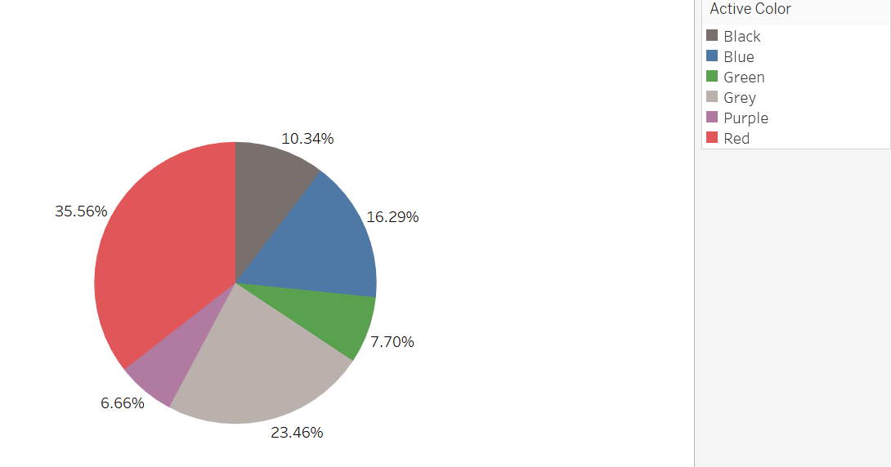
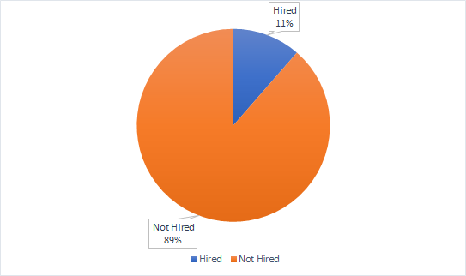
Summary statistics of Contacts file
There are totally 65,549 clients.
There are around 653 variables.
Around 70% of these variables have missing values.
125 out of 653 variables don’t have any missing values.
7347 of the clients were confirmed hired clients.

Slide 7
Business Problem 1
What measures should we utilize to measure process efficiency and program performance relevant at the Veteran Transition Specialist, office, and regional levels, and are there alternative measurement techniques to maximize reporting accuracy and efficiency?

Slide 8
Efficiency and program performance relevant at the Veteran Transition Specialist, office, and regional levels
Data preparation:
Each client in the contact file was mapped to the employee they were assigned to. The hire heroes’ employees were listed in the user file
Information regarding the employee’s location, position etc were also obtained from the User file
From the contact file, the clients hired status, time to get hired, time taken to finish the hire heroes’ processes were taken.
Client who had a confirmed hire date were considered as hired
There were around 1100 employees under Hire Heroes. But around 900 odd records had missing values for regions. Hence only the handful records which had region wise information were considered for the region wise performance analysis.

Slide 9
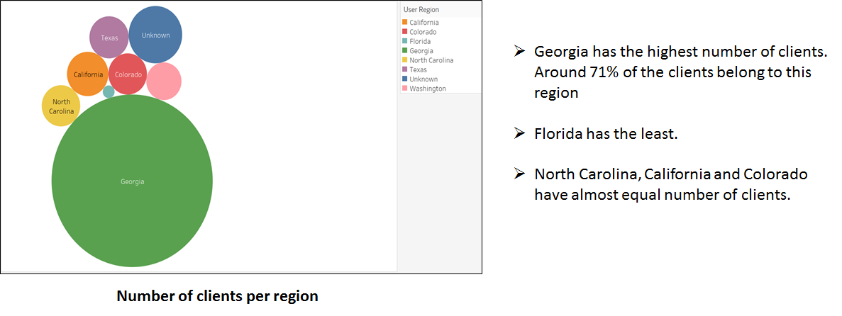
Number of Clients per region

Slide 10
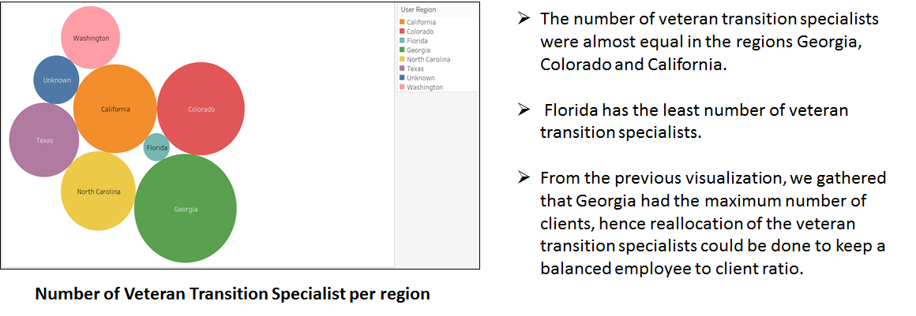
Number of Veteran Transition specialist per region

Slide 11
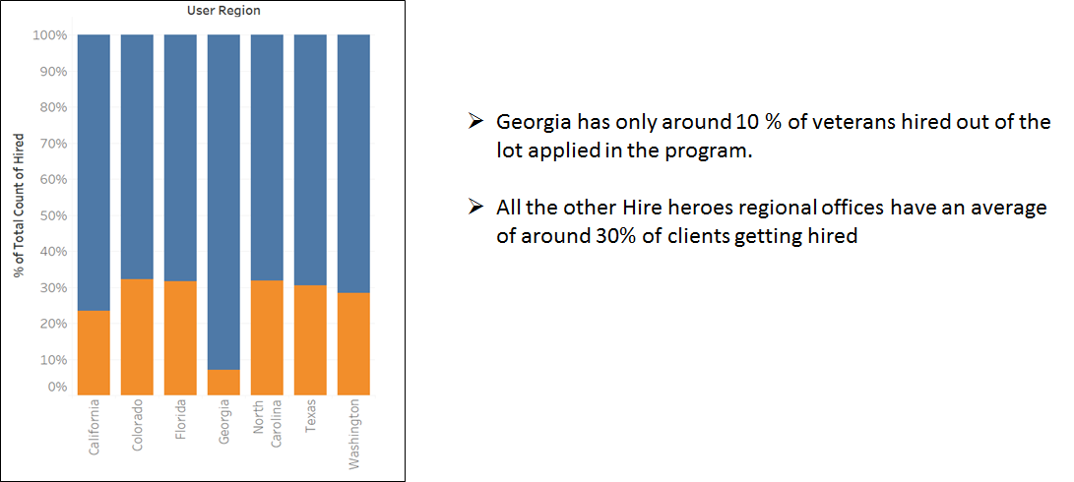
Total hired percentage per region

Slide 12
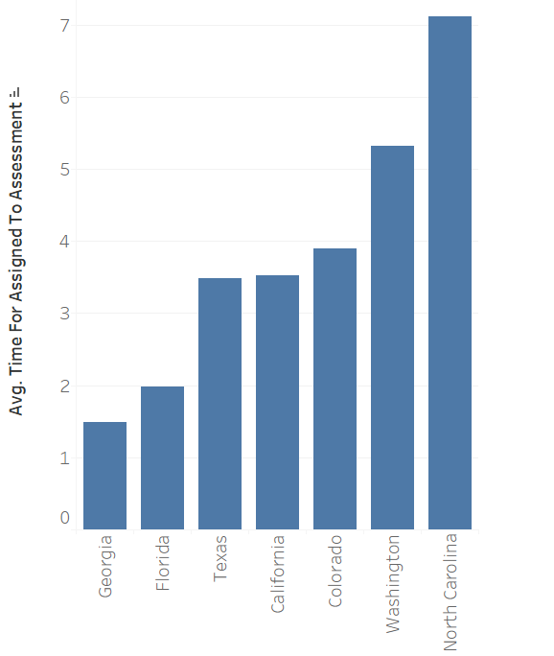
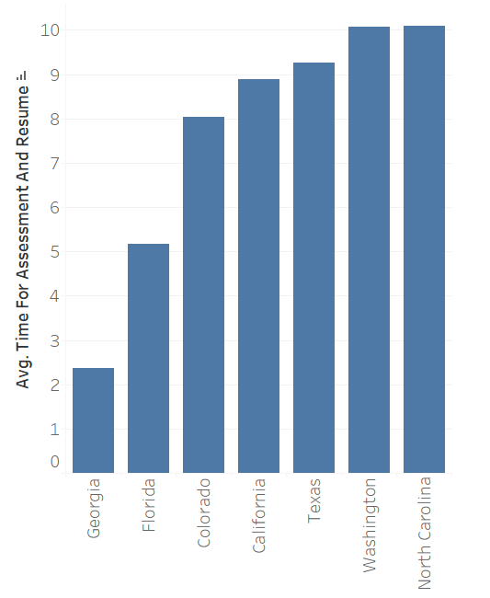
Processing time by region
Interestingly, in both the bar graphs considered it could be clearly seen that Georgia region office in an average takes very less time for the client to be assessed and also to prepare the resume of the client after assessment.

Slide 13
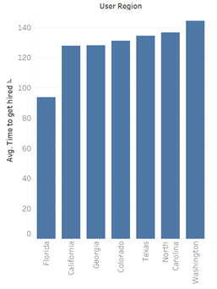
Average time to get hired for each region
Florida ranks first with less than hundred days to get hired.
Washington is last in the list with an average greater than 140 days to get hired.

Slide 14
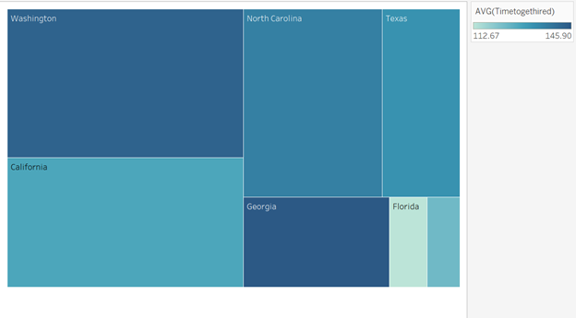
Relation between time to get hired and the time taken to complete processes(by region)
The intensity of the color represents the time to get hired and the size of the blocks represent the time taken for the various processes by the employees
An exact relationship could not be inferred from the tree map
It can be seen that in Florida region time taken for the process is less and also the clients get hired quickly. Though, people take more time to get hired in Georgia, the time taken for the process is less.

Slide 15
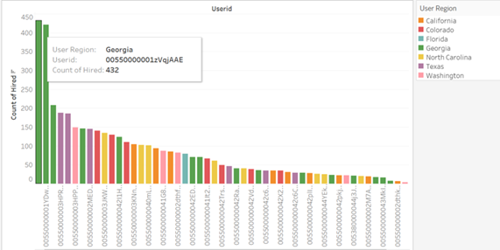
Number of veterans hired under Veteran Transition Specialist
The top three veteran transition specialist who have the highest number of veterans hired under them are from Georgia

Slide 16
Inference and recommendations
Systematic maintenance of employee records required.Majority of the employee’s region were missing.
Georgia had the maximum number of clients.The number of veteran transition specialist wasn’t distributed proportionally.Reallocation of veteran transition specialists required to maintain a balanced employee to client ratio.
Though Georgia had the maximum number of clients,the conversion rate for Georgia was less than average. More veteran transition specialists can be deployed here and a deep dive analysis could be carried out to find the reason for the same.

Slide 17
Business problem 2
Is it possible to correlate client and employer demographic data (candidate qualifications, geography, industry, desired career fields etc.) and our current method of matching clients with potential employers to identify new effective ways to help clients connect with companies we’ve built relationships with?

Slide 18
Data preparation
Data Preparation:
Clients who had a confirmed hired date were considered as hired.
The dataset had to be cleaned first, column which had more than 70% of missing values were removed.
From the final data set prepared the following were selected as independent and target variables.
Target Variable – Hired or Not
Independent Variables:
- Areas of Experience
- Disability Rating
- Education Summary
- Summary of Qualification
- Desired geographic location
- Desired industry to work in

Slide 19
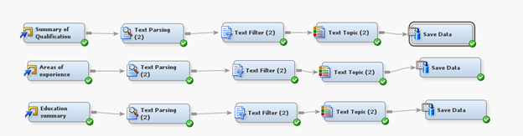
Text Mining of Text variables
Three variables namely Areas of Experience, Education Summary and Summary of Qualification were text.
Hence text mining was chosen to be done to obtain text topics and categorize each record into the text topics.

Slide 20
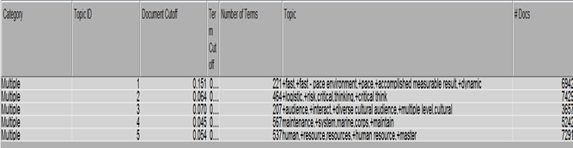
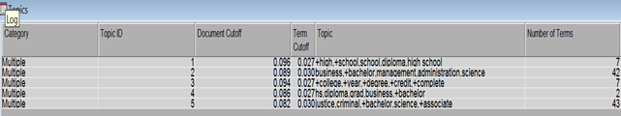
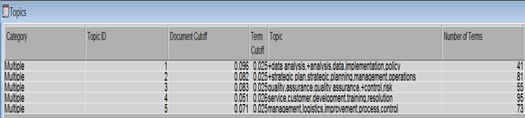
Text Topics of each text variable
Summary of Qualification:
Cluster 1 – Fast and Dynamic
Cluster 2 – Logical and critical thinking
Cluster 3 – Culturally Interactive Quality
Cluster 4 - System Maintenance
Cluster 5 – Human Resource
Education summary:
Cluster 1 – High school graduate
Cluster 2 - MBA
Cluster 3 – College graduate
Cluster 4 – Diploma or bachelor degree
Cluster 5 – Law related degree
Areas of experience:
Cluster 1 – Data Analytics
Cluster 2 – Strategic planning and operations Management
Cluster 3 – Quality Assurance
Cluster 4 – Customer Service
Cluster 5 – Logistics and Process control

Slide 21
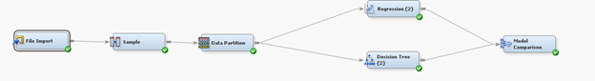
Modeling
Logistics regression and decision trees were considered appropriate for this case as the target variable is binary. These two models were run and compared to predict the likelihood of being hired.
Data was portioned into train and validate in the ratio 3:2.

Slide 22
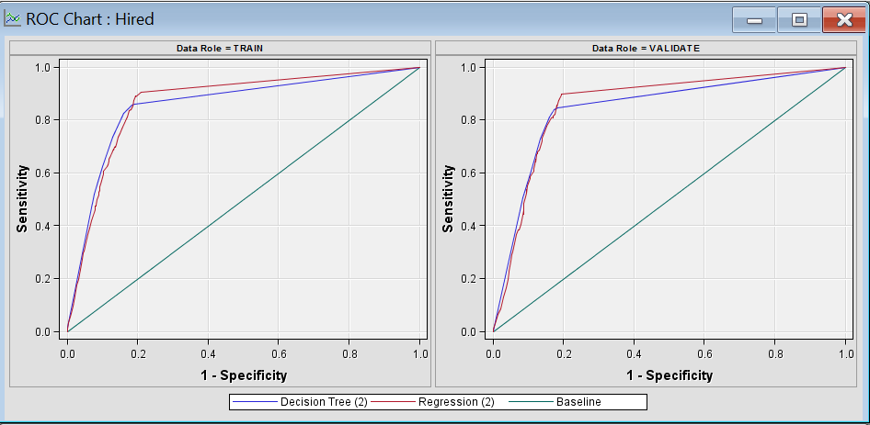
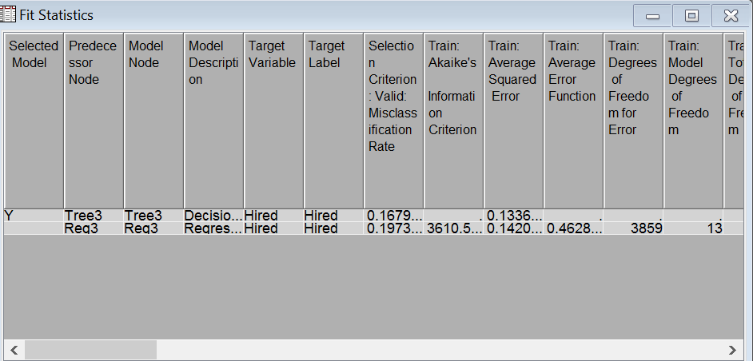
Model comparison results
Decision tree emerges as the better model

Slide 23
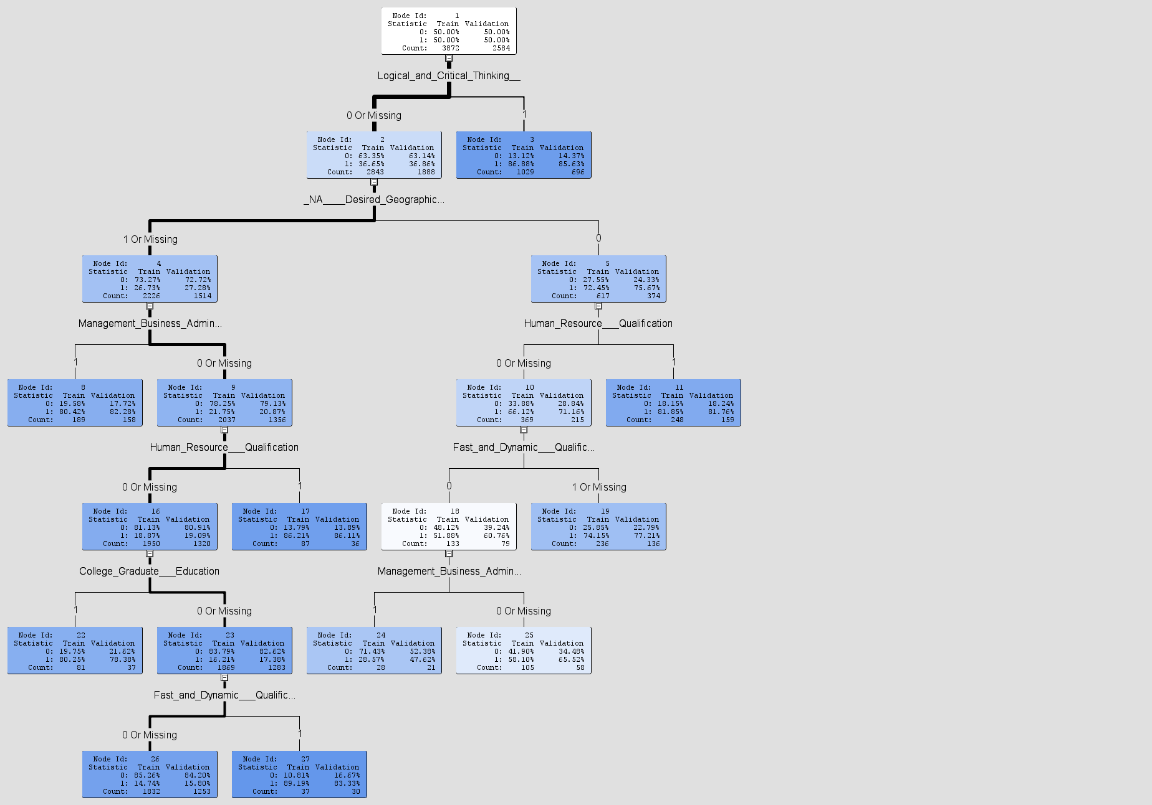
Decision Tree

Slide 24
Recommendations
Based on the decision tree results, we have come up with the below recommendations:
Veterans who possess logical thinking skills and are fast paced have more probability of getting hired. Hire Heroes should train their veterans in activities that will enable the veterans to gain these skills.
Also, MBA degree holders and veterans who are qualified in Human Resources have high probability of getting hired.
Being a college graduate also plays a vital role in getting hired.

Slide 25
Business Problem 3
Is there any relationship between the amount of time spent working with individual clients (time to complete an assessment, time to complete resume, # of logged activities, etc.) and how quickly they are employed?

Slide 26
Data Preparation
DATA PREPARATION:
Contact Data has Total of 64,549 records. Below columns were used to determine the relationship between the amount of time spent working with individual clients and how quickly they are hired.
Bus_Days_between_Assigned_and_Assessed__c = (Dat_Initial_Assessment_was_Completed__c - Date_assigned_to_staff__c) – Interval Input.
Bus_Days_between_Assessment_and_Resume__c = (Date_Resume_Completed__c-Dat_Initial_Assessment_was_Completed__c) – Interval Input.
Days_to_get_hired = Date_Turned_Blue__c-Date_turned_green__c – Target.

Slide 27
Data Preparation
Ambiguous records(ex: Veteran hired date is before date_turned_green) were omitted from the analysis.
Below are some of the logged activities by veterans – Nominal Input.
→Attended_Day_1__c
→Attended_Day_2__c
→Compass_Participant__c
→Career_Counseling_Sessions_Number_given__c
→Date_Attended_HHUSA_Workshop__c
→Career_Opportunity_Day_Participant__c
→Created_LinkedIn_account__c
Total Number of logged activities were calculated by taking the count of each activity mentioned above.
Records with missing values or NA’s were removed from the analysis.

Slide 28
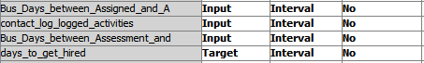

Regression Model
Linear Regression is performed with 3 Interval Inputs and 1 Target.
The final data set has only 2401 records. Out of 65,549 clients, only 7347 clients had a confirmed hire date. Out of 7347 records, only 2401 records were unambiguous since they had positive days between assigned and assessed, assessment and resume.

Slide 29
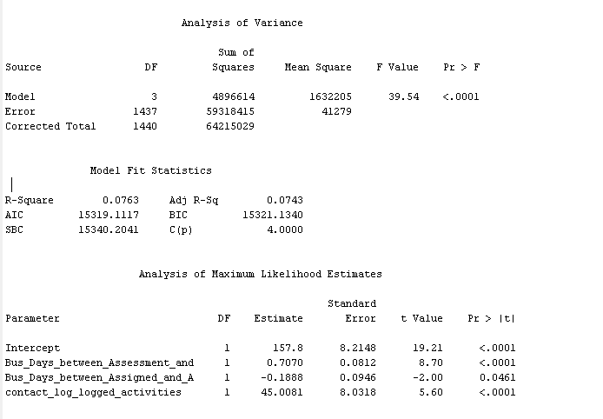
Model Results

Slide 30
Inference
We can infer from the results that days to get hired for a veteran decreases as the Business days between Assigned and Assessed (Assessment Time) increases.
Also when the Business days between Assessment and Resume (Resume Time) decreases, the number of days to get hired decreases.
But surprisingly we see that, if number of logged activities increases, the number of days to get hired also increases.
The R-squared value is very less, which implies that only 7% of the variance in data is explained by the model.This tells us that there are other reasons which influences the clients to get hired.

Slide 31

Improved Regression Model
To improve the R-squared value and to make a meaningful model, factors that might effectively influence veteran’s success in getting hired quickly are been analyzed and has been added as input to the model. They are
Geographic region of veteran
Areas of Experience of the veteran
Educational Summary of the veteran
Qualification Summary of the veteran
Volunteer help
Interview Skills
Responsiveness of the veteran

Slide 32
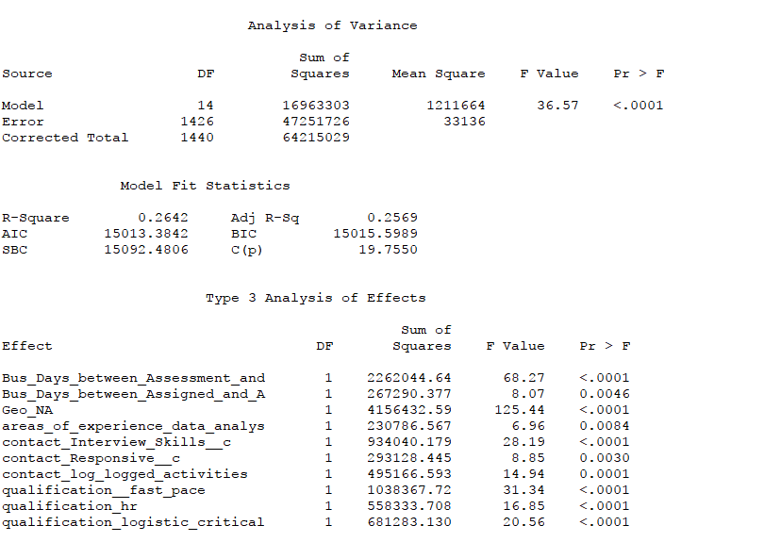
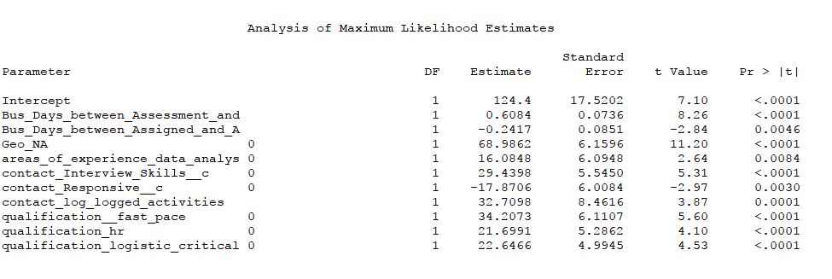
Improved Model Results

Slide 33
Inference
In addition to the existing takeaways from the results we see that,
Geography of a veterans place doesn’t matter much in finding them a job.
When the Veteran is responsive to HHUSA clients, then the number of days to get hired significantly decreases.
Qualification Summary of veteran: Fast pace, HR, Logististics and Critical Reasoning. Only these three were significant for a veteran to get hired.

Slide 34
Recommendations
Based on the results, we have come up with the following recommendations
It is recommended that HHUSA employees take sufficient amount of time to assess the veterans. Because, it would help them to get a better idea of the person and would help them in finding a relevant job sooner.
Once this is followed, it would obviously decrease the number of days taken for writing a resume for the veteran. So, it is recommended that HHUSA employees take less number of days for Resume Writing.
Veterans should be more responsive to HHUSA people. So, HHUSA can take necessary measures to increase the communication and responsiveness between them and the veterans.

Slide 35
Business Problem 4
Does working with a volunteer raise the probability of a client getting hired or getting hired sooner? Are there certain volunteer activities that are more effective than others? Do volunteer activities increase the quality job obtained perhaps determined through salary level? (Essentially, can we prove quantitatively that our volunteers are increasing the overall effectiveness of our program?)

Slide 36
Data Preparation
Case data only appears if the client requested or responded to an offer for volunteer services. So, if a client has no case data in their record, they did not want to speak with a volunteer (or weren’t offered the service).
Case Data has 1,826 records, out of which 958 records has “completed” status meaning that only these veterans completed their volunteer request while others had withdrawn or did not respond to request.
Contact Data has 64,549 records. Both these datasets were joined by matching their contact Id’s using R.
After removing duplicates, 842 veterans were identified to have used the volunteer service.
The columns that are of interest are :
volunteer_c (Veteran used volunteer service or not; binary)
Blue_c ( Hired or Not; binary)
if(Active_color_c = “Blue”) then 1 else 0 ;
Salary_Range__c
Volunteer_Services__c
Days_to_get_hired (Date_Turned_Blue__c - Date_turned_green__c )
Salary_Range__c column contains the min-max range of salary for each veteran (ex : $40,000 - $55,000). Average salary for each veteran was calculated from the given range.

Slide 37
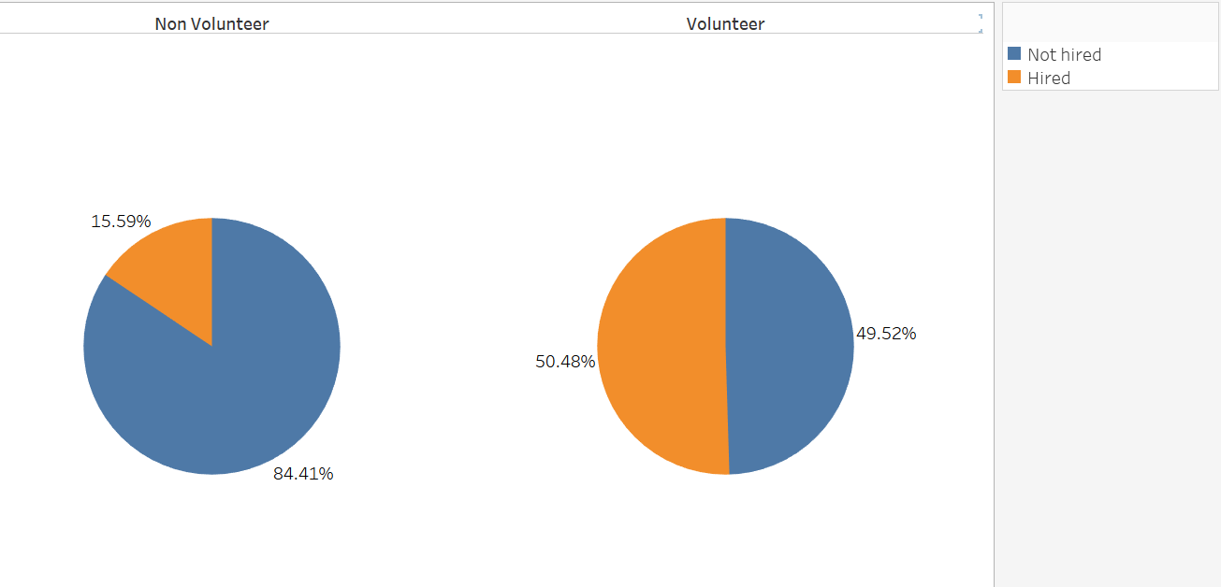
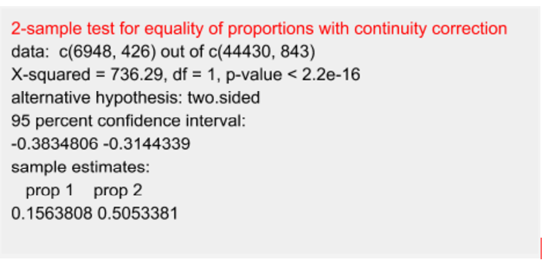
Volunteer VS Non Volunteer
Statistical Tests :
Around 50% of the veterans who took the help of volunteers got hired, whereas only 15% got hired among the veterans who did not get any volunteering service.
Logistic Regression : log(odds of getting hired) = -1.68541 + volunteer_c * 1.70676
This indicates that log odds of getting hired increases by 1.7 times when the veteran is offered volunteering service.

Slide 38
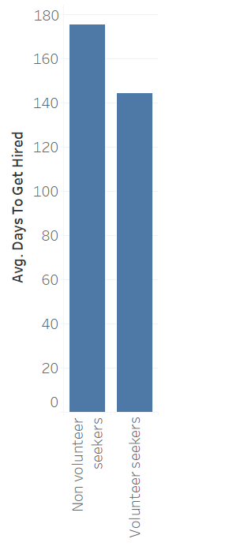
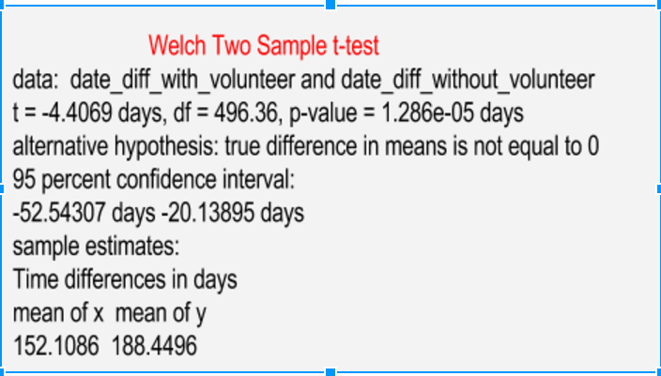
Days to get hired with Volunteering
On an average, it took 152 days to get hired for an veteran who used a volunteer, whereas it took 188 days to get hired without volunteering.
Linear Regression Model : Days_to_get_hired = 188.45 - volunteer_c * 36.34
This shows that days to get hired decreases by 36 times when the veteran is offered volunteer service.

Slide 39
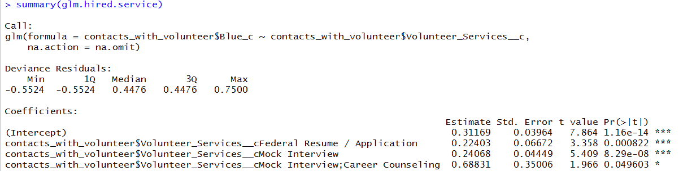
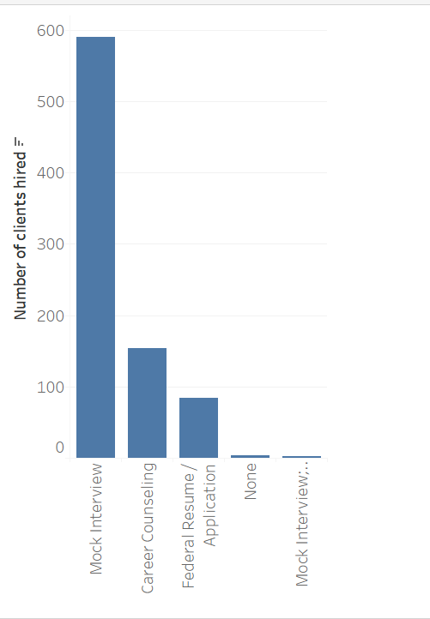
Are there certain volunteer activities that are more effective than others?
Results shows that Veterans who took the Mock interview sessions from the volunteers were hired in large numbers.

Slide 40
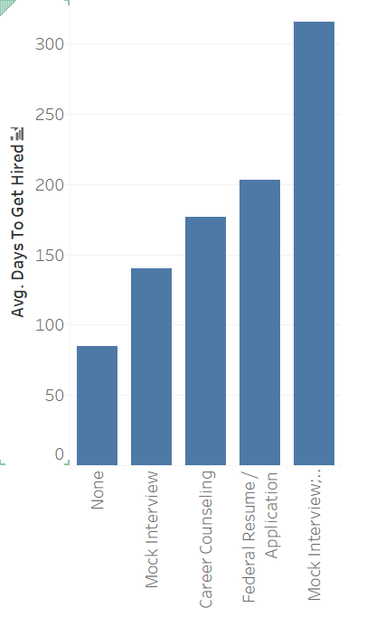
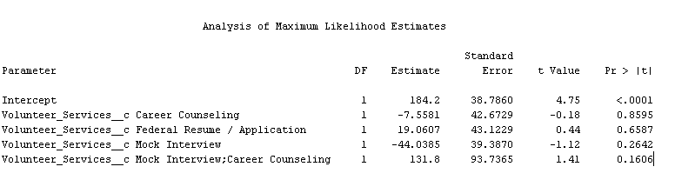
Effect Of Volunteer services on days to get hired
Linear Regression Model
None of the above terms are significant. We can say that, Although certain type of Volunteer services has a positive effect on getting hired, it does not seem to help veterans in getting hired soone.r

Slide 41
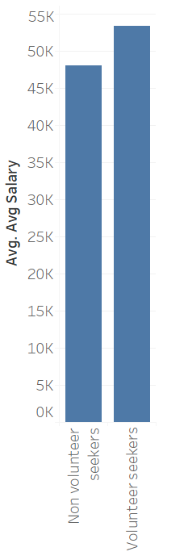
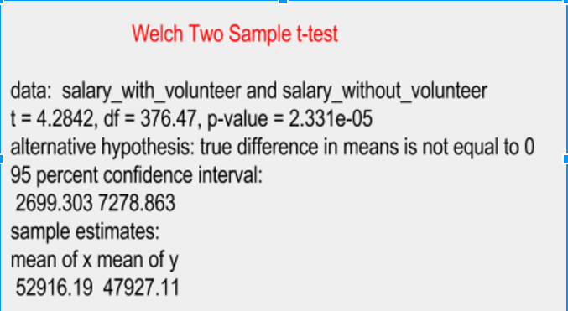
Job Quality of veterans who were offered Volunteer Services (in terms of Avg. Salary)
Average salary of veterans who got hired with volunteering service is more when compared to the ones who did not get any volunteer service offered.
Linear Regression Model : Average salary of a candidate increases by 4,989 times if volunteering service was offered.
Avg_salary = 47927 + volunteer_c1 * 4989

Slide 42
Improved Regression Model :
To improve the R-squared value and to make a meaningful model, factors that might effectively influence veteran’s success in getting hired quickly are been analyzed and has been added as input to the model. They are
Geographic region of veteran
Areas of Experience of the veteran
Educational Summary of the veteran
Qualification Summary of the veteran
Interview Skills
Responsiveness of the veteran
Days Between Assessed and Assignment
Days Between Assessment and Resume

Slide 43
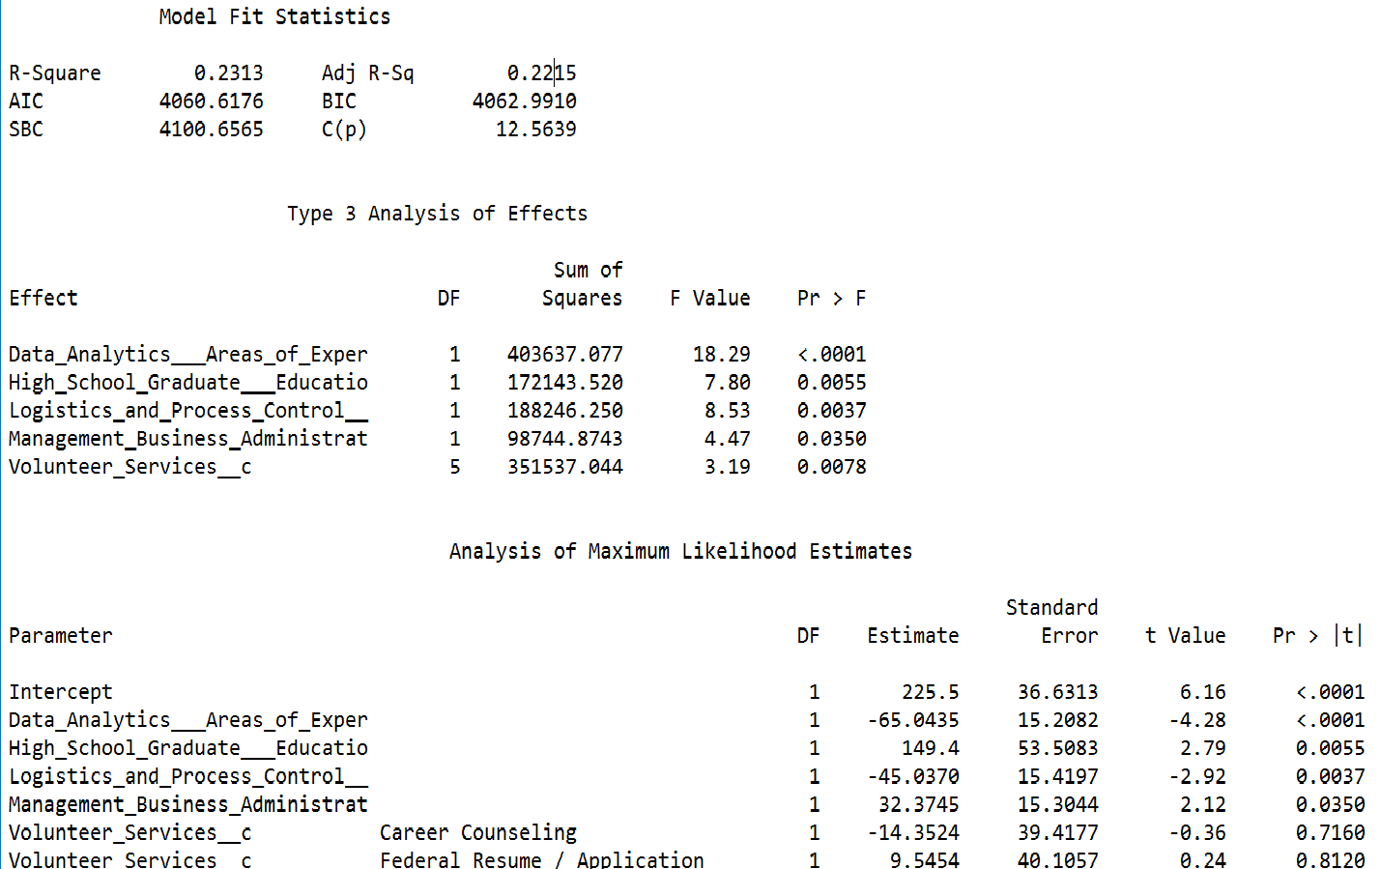
Improved Model Results

Slide 44


